Slide 1
The Processes of MI: Plan
Chapter 5
Companion slides to Motivational Interviewing in Nutrition and Fitness
ISBN: 9781462524181 © 2016 Dawn Clifford and Laura Curtis
Guilford Press • 370 Seventh Ave Suite 1200 • New York, NY, 10001-1020 • guilford.com

Slide 2
Learning Objectives
By the end of this presentation, participants will be able to:
Describe how to approach the planning process in a way that honors client autonomy
Describe how to provide information to clients while maintaining their engagement
List questions that are used to guide the client in the goal-setting process

Slide 3
The Four Processes of MI
To recap, here are the four processes of MI:
Engage
Focus
Evoke
Plan
Plan

Slide 4
The Four Processes of MI
Engage Shall we travel together? | Warm, friendly greeting Make introductions Rapport building Let the client know what to expect Determine the reason for the visit
Focus Where to? | Invite the client to select a topic to discuss Present topic ideas to the client if the client is unsure Find out the reason behind the topic selection
Evoke Why? | Invite the client to explore WHY he/she wants to make a change Identify and respond to ambivalence Evoke change talk Assess readiness to change
Plan How? | Invite the client to discuss HOW he/she will make the change Offer information, if needed Invite client to set goals Invite client to explore potential barriers and solutions

Slide 5
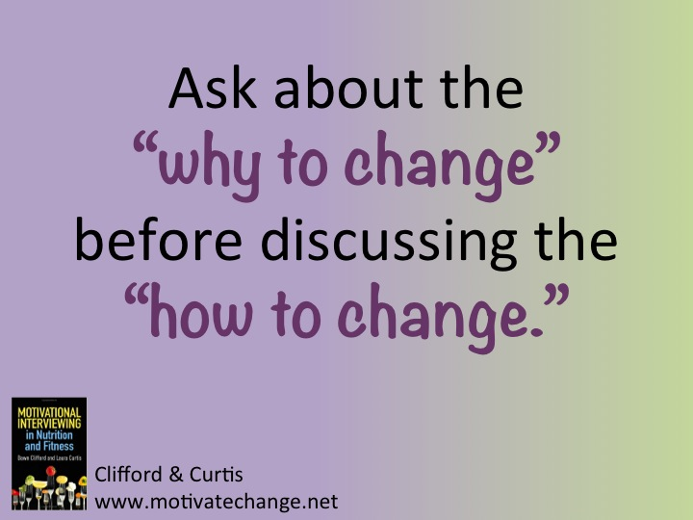

Slide 6
Outline
Respecting Client Autonomy
Elicit – Provide – Elicit
Giving Advice
Offering a Concern
Client-Centered Goal-Setting
Setting Up an Experiment
Assessing Confidence and perceived barriers to change

Slide 7
Respecting Client Autonomy
walk at lunch
The planning process often involves a brainstorming of change ideas.
Let the client lead the brainstorming process.
hike
ride my bike
frisbee
play tag with my kids
“What ideas do you have for how you might go about making this change?”

Slide 8
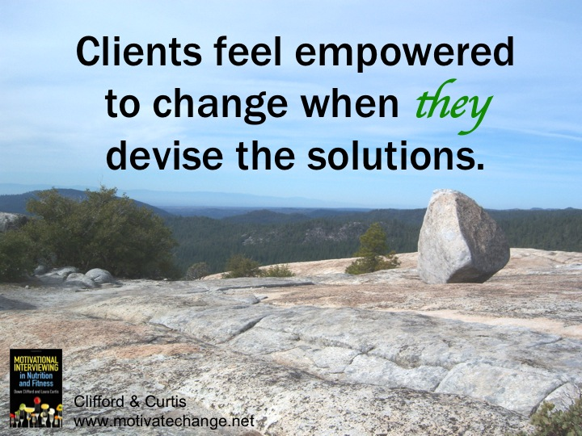

Slide 9
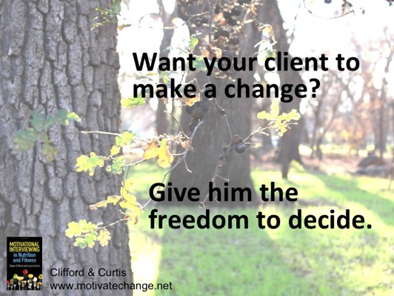
Respecting Client Autonomy
Refrain from pelting ideas at the client.
Ask the client for ideas first.
Offer ideas only if the client gets stuck.
Ask for permission before offering ideas.
“Would you be interested in hearing some ideas that have worked for other clients of mine?”

Slide 10
Elicit – Provide – Elicit
An Information Sandwich
Ask a question
Also known as:
Explore – Offer – Explore
Ask – Offer – Ask
Minimizes long monologues of information-giving.
Breaks up information-giving by asking the client questions
Find out what the client already knows about a topic before giving information.
Give information
Ask a question

Slide 11
Elicit – Provide – Elicit
Questions that could be asked
First elicit:
What have you heard about…?
What do you already know about…?
What are your thoughts about…?
Second elicit:
What do you think about what I just said?
What is your reaction to what you just heard?

Slide 12
Elicit – Provide – Elicit
When giving information (provide), notice the client’s reaction (non-verbal cues) to assess understanding and engagement.
Enforce client autonomy with:
“Which of these ideas, if any, might work for you?”
“You know what works best for you.”
“It’s up to you.”
“Or perhaps you have thought of other ideas that might work better?”

Slide 13
Elicit – Provide – Elicit
Pieces of information that might be provided:
Lab results
Information about a specific disease state
How to manage a specific disease state or condition
Behavior changes clients with a certain condition often make
Information about a specific concept or paradigm
Correcting misinformation
A list of ideas, tips or strategies for the client to consider
Give 3-5 options for the client to choose from

Slide 14
Elicit – Provide – Elicit
Examples of lists of ideas for the client to consider
Adding protein and fiber to snacks Apples and peanut butter String cheese and grapes Trail mix (nuts and dried fruit) Granola bar |  | Drinking more water Bring water bottle to work/school Flavor water to make it palatable Drink a full glass of water when brushing teeth or taking medicine
Low cost indoor physical activity Free exercise videos on-line Dancing in the living room Bicep curls with cans or jugs Sit-ups, push-ups and lunges |  | Making physical activity fun Add music/headphones Listen to a podcast Invite a friend Take lessons for a new sport

Slide 15
Elicit – Provide - Elicit
Elicit | What do you already know about…? What ideas do you have for...?
Provide | If it’s ok with you, I’d like to share a little more information about… If you’re interested, I could share some ideas that have worked for other clients…
Elicit | How does the information I just provided align with your own experience? What do you think about those ideas?

Slide 16
Elicit – Provide – Elicit
E
Practitioner: What ideas do you have for how you would like to go about adding more bouts of activity throughout the day?
Client: I could take the stairs instead of the elevator at work. I only work on the fourth floor. It’s not too far to climb.
Practitioner: Taking the stairs feels fairly doable to you. What other ideas do you have?
Client: That’s the only thing I can think of.
Practitioner: If it’s ok, I could share some other ideas that might help.
Client: That would be great.
Practitioner: Some of my clients set an alarm at their desk and take stretching breaks a few times a day. Others prefer getting off at a subway or bus stop that is a little bit further from work and some prefer to take a walk during a lunch break.
Practitioner: In addition to taking the stairs, which, if any, of these ideas appeal to you?
P
E

Slide 17
Elicit – Provide – Elicit
E
Practitioner: What have you already heard about fiber-rich foods?
Client: Well I know they are good for your heart. And I believe fiber is in certain grains.
Practitioner: Yes, that’s true. There are a few other facts about fiber you might be interested in hearing. Can I share those with you?
Client: Yes, that would be helpful.
Practitioner: Fiber also helps with constipation and general gut health. It fills you up, keeping you satiated between meals. In addition to the whole grains you mentioned, fiber can also be found in fruits, vegetables and legumes.
Client: Oh, interesting.
Practitioner: What are your thoughts on what I just said?
P
E

Slide 18
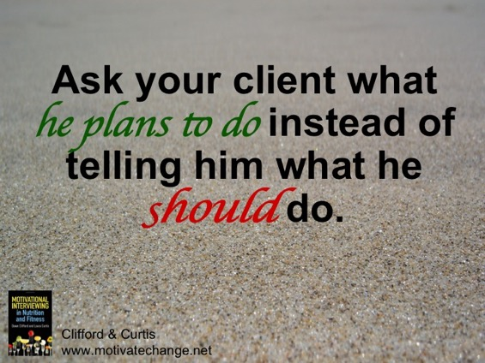
Giving Advice
Giving unsolicited advice often results in sustain talk and discord.
Avoid using imperatives such as:
You should…
What you want to do is...
What you need to do is...
Instead, ask the client for ideas.
Provide your ideas when the client gets stuck:
Some of my clients have found...others have found...what do you think will work for you?

Slide 19
Offering a Concern
I’m not really a morning person, and I don’t really like running, but I’m thinking about getting up early each morning and going for a run.
Sometimes clients have unrealistic ideas.
Don’t shoot down their ideas.
Guide clients to come to that conclusion on their own.
If they aren’t able to see the flaws in their plan, ask permission to offer a concern.

Slide 20
Offering a Concern
Client: I’d like to aim for going to the gym seven days a week.
Practitioner: Ok, so everyday. What concerns do you have, if any, about this ambitious goal?
Client: I’m just getting over a really bad cold, so I could see how being sick might make it a little challenging.
Practitioner: Yes, good point. Any other concerns?
Client: No, I should be able to do it as long as I’m feeling well.

Slide 21
Offering a Concern
Practitioner: You seem motivated and I don’t want to squash those feelings. I have some concerns and I’m wondering if I could share those with you.
Client: Sure.
Practitioner: Many of my clients have found that when they set a lofty goal, they are usually successful at first and then their motivation wanes as time passes, which can really influence self-confidence. And sometimes life happens – a flat tire, a snowstorm, or a stressful week – and it often helps to build in some flexibility so that you’re still able to reach your goals. What do you think about what I just said? Can you think of a physical activity goal that feels more sustainable in the long run?

Slide 22
Client-Centered Goal Setting
Some clients like to leave with a specific goal.
Examples:
Sign up for a yoga class.
Add a cooked vegetable to dinner three nights a week.
Start packing an afternoon snack to have on hand at work four days a week.
Provide a toddler with water instead of juice or soda between meals.
Look for new recipes that take less than 20 minutes to make.
Try at least one new recipe in a week.

Slide 23
In Class Activity
Write a list of 10 specific behavior change goals that you believe would be doable for most clients on the topic of increasing fruits and vegetables. The first one is done for you.
Make fruit smoothies for breakfast two days a week.______________
__________________________________________________________
__________________________________________________________
__________________________________________________________
__________________________________________________________
__________________________________________________________
__________________________________________________________
__________________________________________________________
__________________________________________________________
__________________________________________________________

Slide 24
Client-Centered Goal Setting
You have great ideas, but your client’s ideas always come first.
Questions to ask to invite your client to set goals:
Out of all the things we talked about, is there one specific change you’d like to focus on this week?
What ideas do you have for a specific change that feels doable right now?
How many times a week would you like to attempt that change, as you get started?

Slide 25
Client-Centered Goal Setting
Allow the client to lead all parts of the goal setting process.
The client decides the:
What (what change to try out)
When (how often the change will take place)
Where (location where change will take place)
How (how to get started)

Slide 26
Setting Up an Experiment
An experiment is a temporary behavior change goal.
Allow the client to test the waters of change.
Client “collects data” while attempting the change to determine if it’s a change work keeping.
Encourage curiosity and discovery of what works through trial and error.
Invite your client to determine the experiment.
Provide space for your client to think through all the pieces of the experiment.

Slide 27
Setting Up an Experiment
Invite your client to notice whether this is a change worth keeping (data collection of an experiment).
What would you like to pay attention to as you attempt this change?
What would you like to monitor or track as you attempt this change?
How will you decide if this is a change worth keeping?
Invite the client to notice:
Overall taste satisfaction with the food | Emotions / mood
Hunger / fullness levels | Bowel regularity
Endorphins / feeling good | Blood sugar levels
How the change impacts others | Energy levels

Slide 28
In Class Activity
Your client, Kim, would like to start bringing breakfast with her to eat after her 8am class Monday, Wednesday and Friday. Write a short script between you and Kim that includes the following components:
An Elicit-Provide-Elicit (E-P-E) with a list of 3-5 packable breakfast ideas in the ‘P’
At least one ask permission question
Invite the client to set a specific goal to test out the change.
Ask the client how she will decide if this is a change worth keeping.
Start with the key question: Kim, what ideas do you have for quick and easy packable breakfast foods that you could take along?

Slide 29
Assessing Confidence and Perceived Barriers to Change
G.A.B. with the client before the client leaves the session.
Goals: Revisit the experiment or goal the client would like to test out.
Assess confidence: Use a scaling question to assess the client’s confidence in following through.
Barriers: Invite the client to consider any potential barriers that may get in the way.

Slide 30
Assessing Confidence and Perceived Barriers to Change
Goals | “Ok, so you decided that you would like to focus on taking a walk during your lunch breaks and you think you could experiment with trying to do this three days a week.”
Assess confidence | “How confident are you on a scale from 0 to 10 that you can take a walk during a lunch break three days a week, with 0 being not at all confident and 10 being very confident? Tell me more about why you chose that number.
Barriers | What, if anything, might get in the way as you attempt to make this change? What ideas do you have for how you would overcome that barrier?

Slide 31
In Class Activity
Continue the script from the previous activity (Kim’s grab-and-go breakfast ideas).
Add on elements of the G.A.B. to increase the client’s confidence in making the change and troubleshoot any specific barriers as you conclude the session.

Slide 32
Take Home Messages
Before giving your client information…
Take the time to build rapport/engagement.
Evoke change talk and provide information once your client expresses readiness to make a change.
Check to see what ideas the client has before providing your own ideas.
Ask the client’s permission before providing ideas.
Invite the client to think through all pieces of a specific change goal and discuss potential barriers.

