Slide 1
The Processes of MI: Evoke
Chapter 4
Companion slides to Motivational Interviewing in Nutrition and Fitness
ISBN: 9781462524181 © 2016 Dawn Clifford and Laura Curtis
Guilford Press • 370 Seventh Ave Suite 1200 • New York, NY, 10001-1020 • guilford.com

Slide 2
Learning Objectives
By the end of this presentation, participants will be able to:
Describe the purpose of the evoking process
List the different types of change talk
Describe ways to respond to ambivalence
List questions that can be used to elicit change talk
Describe how to transition to the planning process

Slide 3
Outline
Identifying ambivalence
Sustain talk
Different types of change talk
Responding to ambivalence
Preparing for planning

Slide 4
The Four Processes of MI
To recap, here are the four processes of MI:
Engage
Focus
Evoke
Plan
Evoke

Slide 5
The Four Processes of MI
Engage Shall we travel together? | Warm, friendly greeting Make introductions Rapport building Let the client know what to expect Determine the reason for the visit
Focus Where to? | Invite the client to select a topic to discuss Present topic ideas to the client if the client is unsure Find out the reason behind the topic selection
Evoke Why? | Invite the client to explore WHY he/she wants to make a change Identify and respond to ambivalence Evoke change talk Assess readiness to change
Plan How? | Invite the client to discuss HOW he/she will make the change Offer information, if needed Invite client to set goals Invite client to explore potential barriers and solutions

Slide 6
Identifying Ambivalence
Change talk:
favors change
Sustain talk:
favors status quo

Slide 7
Identifying Ambivalence: Sustain Talk
Sustain talk sounds like…
“I just can’t eat breakfast, because I’m always rushing out the door. There’s no time.”
“I can’t function without my coffee.”
“A gym membership would be too expensive and it snows six months of the year.”
Other examples?

Slide 8
Identifying Ambivalence: Change Talk
Change talk sounds like the DARN CAT:
Desire to change | Commitment to change
Ability to change | Activation
Reasons to change | Taking steps
Needs for change

Slide 9
Identifying Ambivalence: Change Talk
Desire to change “I really want to stop snacking when I’m not hungry.” | Commitment to change “I am going to start drinking more water and less juice.”
Ability to change “I cut back on the salt, so I know I can do this too.” | Activation “I signed up for a tennis class that starts next week.”
Reasons to change “If I eat a little slower, I know I won’t feel so stuffed.” | Taking steps “I started walking the dog more since seeing my doctor.”
Needs for change “I need to be more active. I know it would help my heart.”

Slide 10
Identifying Ambivalence: Change Talk
Preparatory Change Talk
Mobilizing Change Talk
Desire to change “I really want to stop snacking when I’m not hungry.” | Commitment to change “I am going to start drinking more water and less juice.”
Ability to change “I cut back on the salt, so I know I can do this too.” | Activation “I signed up for a tennis class that starts next week.”
Reasons to change “If I eat a little slower, I know I won’t feel so stuffed.” | Taking steps “I started walking the dog more since seeing my doctor.”
Needs for change “I need to be more active. I know it would help my heart.”

Slide 11
Identifying Ambivalence: Change Talk
Preparatory Change Talk
Mobilizing Change Talk
D.A.R.N.
C.A.T.
Preparatory change talk is the up hill work, meaning the client may still be on the fence about change.
With mobilizing change talk, intentions to change are often higher.

Slide 12
In Class Activity
Label each client response with either a P for Preparatory Change Talk (D.A.R.N.) or a M for Mobilizing Change Talk (C.A.T.).
1. __________ | “I like salsa dancing. I’ve done that in the past.”
2. __________ | “I’ve been researching gyms and found one that’s not too pricey.”
3. __________ | “I’m going to start packing my lunch more often instead of eating out all the time.”
4. __________ | “I want to eat more salads but I’m sort of picky when it comes to salad dressings.”
5. __________ | “My doctor told me to see you because he said my blood sugars were up.”
6. __________ | “I’ve been wanting to do more knitting, so I’m going to knit scarves while I watch TV instead of snacking.”
7. __________ | “I know my children would love it if I played outside with them. It would be good for both of us.”
Notes:
P
M
M
P
P
M
P

Slide 13
Identifying Ambivalence
Obvious ambivalence | Honest, up-front “I know my doctor wants me to walk more, but I hate walking in this weather.”
No signs of ambivalence | Overly confident Often unaware of the challenging nature of behavior change “Just tell me what to do, and I’ll do it.”
Mixed messages | Verbal and non-verbal communication doesn’t line up “I guess I could try that. Can I get my food vouchers now?”

Slide 14
Responding to Ambivalence
Reflective listening is the best way to respond to ambivalence.
Practitioners use reflective listening to:
try to understand the client’s experience
take a guess at the client’s meaning
highlight pieces of what the client says for the client to hear

Slide 15
Responding to Ambivalence
Two ways to use reflective listening:
Reflect both sides of the ambivalence.
Also known as a double-sided reflection
First, reflect the sustain talk and then reflect the change talk.
Client is more likely to speak what is said last.
Practitioner: On one hand, you are busy and find it hard to cook at home and on the other hand, you’re finding that eating out all the time is expensive.
Client: Yes, I bet if I saved that money I could treat myself to a pretty nice vacation a year from now.
green = change talk
red = sustain talk

Slide 16
Responding to Ambivalence
Two ways to use reflective listening
Reflect only the change talk
Sometimes it makes sense to validate the sustain talk you hear and other times, it isn’t necessary
At times, change talk from a client is subtle
Highlight the subtle change talk to emphasize it
Client: I need to get more sleep. If I go to bed late, it’s hard to wake up and exercise in the morning.
Practitioner: You’ve noticed that good sleep leads to success.
green = change talk
red = sustain talk

Slide 17
Responding to Ambivalence
Use open-ended questions to elicit more change talk.
What is important to you about this change?
How would your life be different if you made this change?
How is what you’re doing right now not working for you?
What’s motivating you to make this change?
What’s the best part about making this change?

Slide 18
In Class Activity
Which of the following questions would be best for evoking change talk? (Write down or circle all that apply.)
Why might now not be the best time to make a change? | What has prevented you from making this change in the past?
In what ways would making this change improve your life? | What are some of the benefits you’re hoping to experience as you attempt to make this change?
What might get in the way of you making this change? | What are some other reasons you’d like to make this change?
What is it about this change that excites you? | So on a scale from 0 (not at all important) and 10 (very important), you chose a 7. What kept you from choosing an 8 or a 9?

Slide 19
Responding to Ambivalence
The evoking process is all about…
Reflecting the change talk you hear
Asking questions that elicit more change talk
Practitioner: How would you feel a few weeks from now if you were successful making this change?
Client: I’d probably feel like a million bucks! I mean, I know I’d be a little sore at first, but after that passes, I’d probably be less stressed out, sleeping better, and have more confidence.
Practitioner: It would help you physically and mentally. Tell me more about the mental benefits you’ve noticed in the past when you were more active.

Slide 20
The Four Processes of MI
Engage Shall we travel together? | Warm, friendly greeting Make introductions Rapport building Let the client know what to expect Determine the reason for the visit
Focus Where to? | Invite the client to select a topic to discuss Present topic ideas to the client if the client is unsure Find out the reason behind the topic selection
Evoke Why? | Invite the client to explore WHY he/she wants to make a change Identify and respond to ambivalence Evoke change talk Assess readiness to change
Plan How? | Invite the client to discuss HOW he/she will make the change Offer information, if needed Invite client to set goals Invite client to explore potential barriers and solutions
Notes:
How do you know when it’s time to move from evoking to planning?

Slide 21
Preparing for Planning
How do you know when it’s time to start the planning process?
When your client is speaking more change talk
When your client is speaking mobilizing change talk
C.A.T. - Commitment to change, Activation, Taking steps
Response to readiness to change scaling question is high (~7-10)
On a scale from 0 to 10 with 0 being ‘not at all’ and 10 being ‘very,’ how ready are you to make this change?
The amount of time spent evoking depends on the client’s readiness to change.

Slide 22
Preparing for Planning
Before moving into planning…
Be sure practitioner-client relationship is strong
Be sure client expresses readiness to change
Provide a summary of key elements of change talk expressed by the client
Allow the client to lead the way by asking the key question:
How do you think you’ll go about making this change?

Slide 23
Preparing for Planning
Practitioner: On a scale from 0 to 10 with 0 being ‘not at all’ and 10 being ‘very,’ how ready are you to make this change?
Client: I’m at an 8.
Practitioner: Tell me more about your answer.
Client: After talking to you, I realize I have a lot to gain if I move forward with this change.
Practitioner: Yes, you mentioned that eating more fruits and vegetables would likely give you more energy, help you to be more regular and lower your blood pressure, which would reduce your risk of heart disease.
Client: That’s right.
Practitioner: What ideas do you have for how you would add more fruits and vegetables to your meals?
The Key Question

Slide 24
Preparing for Planning
The drawbacks of planning too soon:
The client has a plan, but low motivation
No change happens
Client gets discouraged

Slide 25
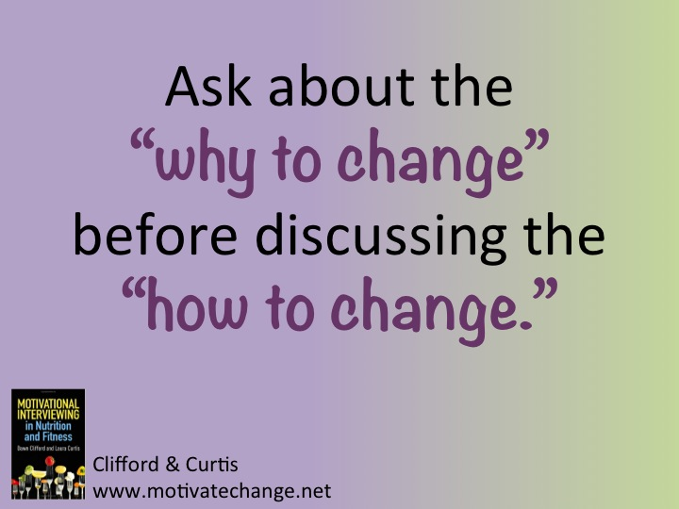

Slide 26
Preparing for Planning
Imagine you have a fish tank and the tank is almost empty.
The fish is your client who is confined by a small amount of water.
The only way to fill the tank with more water is to elicit change talk from your client.
Each time your client speaks change talk, some water is poured into the tank.
Ask evoking questions to fill the fish tank.
Only then will your “fish” (or client) have the motivation to swim freely.

Slide 27
In Class Activity
Tim is noticing that he goes most of the day without eating and then snacks while watching television late at night. He is interested in making the change of adding 1-2 meals or snacks throughout the day and enjoying his evening snack with the television off or temporarily muted (in order to stay more mindful during the eating experience).
Write out a list of at least 7 evoking questions that would be appropriate to ask this client in order to elicit change talk for making this change.
__________________________________________________________
__________________________________________________________
__________________________________________________________
__________________________________________________________
__________________________________________________________
__________________________________________________________
__________________________________________________________

Slide 28
In Class Activity
Pair up with a classmate.
Each person selects a behavior change to discuss with a counselor.
Conduct a brief counseling session to discuss reasons for wanting to make this change.
Decide who will be the counselor first and then conduct the real play:
Counselor starts with this: “Tell me a little about the change you’re thinking of making.”
Counselor asks at least three different evoking questions.
Counselor reflects the change talk spoken by the client after each evoking question is asked.
Counselor summarizes the change talk and ends the session with, “Thank you for sharing your thoughts and feelings about this change.”
Don’t encourage a discussion about how the client will make the change. Avoid “fixing” and stay in the evoking process.

Slide 29
Take Home Messages
Ambivalence is a normal part of the change process.
The purpose of the evoking process is to elicit change talk from the client.
Ask specific questions to elicit change talk.
Highlight the change talk you hear by using reflective listening.
An abundance of change talk demonstrates a readiness to change.

