Slide 1
The Spirit of motivational interviewing
Chapter 2
Companion slides to Motivational Interviewing in Nutrition and Fitness
ISBN: 9781462524181 © 2016 Dawn Clifford and Laura Curtis
Guilford Press • 370 Seventh Ave Suite 1200 • New York, NY, 10001-1020 • guilford.com

Slide 2
Learning Objectives
By the end of this presentation, participants will be able to:
List the four key components of the spirit of MI
Describe the expert trap and explain how it can hinder the client-practitioner partnership
List four ways to express an attitude of acceptance towards the client
Describe the purpose of ‘interviewing’ within the context of a MI session

Slide 3
The Spirit of MI
The practitioner’s underlying mindset or attitude towards the client
Four components
Partnership
Acceptance
Compassion
Evocation
The Spirit of MI
Partnership
Compassion
Acceptance
Evocation

Slide 4
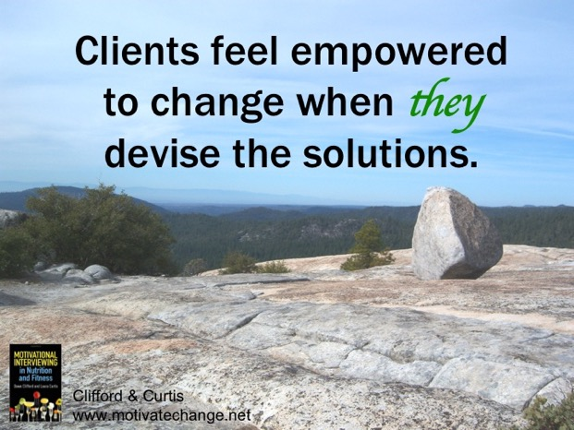
The Spirit of MI
Partnership
The practitioner is the partner or companion.
The practitioner attempts to collaborate with the client’s expertise.

Slide 5
The Spirit of MI
Partnership
The expert trap is when counselors communicate that they have the best answers to their clients’ problems.
Examples:
“The best way to get more fruit in your diet is to make smoothies.”
“You should try yoga.”
“What I do is I pack my lunch the night before.”

Slide 6
The Spirit of MI
Partnership
Expert trap statements often include imperatives such as:
“You should…”
“You really need to...”
“What you need to do is...”
Motivational
Interviewing
because
‘should-ing’
never works.
Clifford & Curtis
motivatechange.net

Slide 7
The Spirit of MI
You might know about nutrition, but your client knows what works.
Clifford & Curtis
motivatechange.net
Partnership
.
4 Reasons to Avoid the Expert Trap
Reduces partnership
The practitioner might come across as “the perfect eater”
The practitioner might not come up with a viable option.
The client knows best what will work.

Slide 8
The Spirit of MI
Partnership
Expert Trap | Partnership
I make fruit smoothies to get more fruit in my diet. | What ideas do you have for adding more fruit? … Would you be interested in hearing an idea?
You should try yoga. It will make you stronger and reduce your stress. | Some activities like yoga are geared toward stretching, strengthening and relaxation. What are your feelings about those types of activities?
If you don’t get your blood sugars under control, your kidneys are going to fail. | What concerns you most about having high blood sugars? … Would you be interested in hearing more about how blood sugars affect the body?

Slide 9
The Spirit of MI
Partnership – Your turn!
Expert Trap | Partnership
If you could just start going for walks during your lunch breaks, that would really help.
You are definitely going to need to cut out all the soda.
I like to put my broccoli in the microwave to steam it. It’s much faster that way.

Slide 10
The Spirit of MI
Acceptance – 4 ways to express acceptance towards your client:
Absolute worth – honoring the inherent value and potential of every human being
Accurate empathy – perceiving and reflecting back another person’s meaning
Affirmation – counselor acknowledges client’s strengths and efforts
Autonomy Support – accepts and confirms the client’s right to choose

Slide 11
The Spirit of MI
Compassion – promote client welfare; giving priority to client’s needs
A genuine concern for the suffering of others
Seeking and valuing the well-being of others
Not in it for self gain
Connecting with others in a meaningful way speeds up recovery from disease

Slide 12
The Spirit of MI
Compassion
Compassion fatigue occurs when we:
Try to fix our clients
View clients’ barriers to change as excuses
Fail to put ourselves in our clients’ shoes
Forget that clients are often suffering from life trials that result in trauma, grief, sadness and stress

Slide 13
The Spirit of MI
Evocation – practitioner elicits client’s perspectives and personal motivations for change
The ‘interviewing’ in motivational interviewing
The purpose of the questioning is to draw out feelings about behavior change
Client motivation increases when they voice reasons they’d like to make a change

Slide 14
The Spirit of MI
Evocation
Examples of evoking questions
“What possible long-term consequences of diabetes concern you the most?”
“What motivated you to make this appointment?”
“What concerns – if any – do you have about your eating habits?”
“What are the reasons you’d like to make a change?”

Slide 15
In Class Activity
Sprit of MI Worksheet
Next to each practitioner statement, write ‘MI’ if the statement is consistent with the Spirit of MI and write ‘Not MI’ if the statement is not consistent with the Spirit of MI.

Slide 16
MI Spirit Worksheet
For each counselor response, indicate whether it is consistent with the spirit of MI. Write either ‘MI’ or ‘Not MI’ on the line. After each counselor response that is MI consistent, explain why in the space below.
“Yes, you really should start some sort of regular walking routine.”
“Well, I have some ideas about what might help, but first let me hear what you’ve already considered.”
“Your daughter’s comment about your weight is ridiculous. I just don’t understand how you put up with her.”
“So what I hear you saying is that you’d like to start eating out less often. That means you’ll really need to start going to the grocery store and planning out your meals.”
“So what I hear you saying is that you’d like to start eating out less often. How do you think you’ll go about that?”
“Your blood sugars are really high. You really need to start watching your diet. Why don’t you start going to our diabetes class?”
“You know what you should do is start paying attention to your food when you eat.”
“Some people have tried adding vegetables to their meals in the form of a side salad, others have tried serving a hot vegetable as a side dish, and still others have tried adding vegetables to their entrees. What do you think you will do?”
“You’re interested in taking diet pills? Why would you do that? They don’t work so it would be a waste of money.”
“You’re quite committed to making this change.”
“It sounds like you’re really adamant about starting the low carb diet your friend is on. I really don’t think you should.”
“It sounds like you aren’t completely convinced that you’d like to start making changes. Whether you decide to try making some changes to your eating habits is completely up to you. What do you think you will do?”

Slide 17
Take Home Messages
The Spirit of MI refers to the mindset or attitude of the MI practitioner.
The four key components of the Spirit of MI are:
Partnership
Acceptance
Compassion
Evocation
An MI practitioner expresses compassion, and empathy while putting the client in the driver’s seat.

