Slide 1
This slide is a supplement to A Geography of Russia and Its Neighbors, Second Edition by Mikhail S. Blinnikov. Copyright © 2021 The Guilford Press.
Chapter 8. Post-Soviet Reforms
Perestroika! (1981–1991) and collapse of the USSR (August–December 1991)
Why did it happen?
Cold War world ca. 1980 – competition of two systems worldwide (map)
Alexander Solzhenitsyn (1918–2008) predicted the collapse
Nobel prize in literature (1970)
GULAG Archipelago
One Day in Life of Ivan Denisovich
Sent to USA in 1974 (lived in Vermont)
Returned in 1994 as a national hero
Fierce critic of the Soviet totalitarianism and advocate for capitalist and nationalist Russian state

Slide 2
This slide is a supplement to A Geography of Russia and Its Neighbors, Second Edition by Mikhail S. Blinnikov. Copyright © 2021 The Guilford Press.
Andrei Sakharov (1921–1989)
Brilliant physicist
Father of the Soviet thermonuclear program
Hydrogen bomb
TOKOMAK inventor (prototype reactor for hydrogen fusion)
Dissident since 1960s
Exiled to Gorky (Nizhniy Novgorod)
Nobel Peace Prize (1975)
Idea of “convergence” between East and West – democratic socialism (as in Sweden)
Released by M. Gorbachev
Was elected a deputy for the People’s Congress in the late 1980s and made fiery speeches advocating reforms and end to Cold War

Slide 3
This slide is a supplement to A Geography of Russia and Its Neighbors, Second Edition by Mikhail S. Blinnikov. Copyright © 2021 The Guilford Press.
Mikhail Gorbachev (1985–1991) faced many issues as the last Soviet leader
Falling economic growth rates
Locational disparity and inefficient resource use
Chernobyl disaster (1986)
Labor issues: “they pretend to pay us, we pretend to work”
Lax workers’ discipline, drinking, stealing items from work
Internal political pressures
No freedom of speech, religion, press, desire for more open exchange of ideas
External political pressures
Afghanistan quagmire (1979–1989)
“Star wars” – R. Reagan’s great bluff that made Soviet Union overspend on defense
Socialist allies – drain (Cuba, North Korea, Vietnam, COMECON states)
falling petroleum prices since 1984 (did Regan set this up with Saudi Arabia?)

Slide 4
This slide is a supplement to A Geography of Russia and Its Neighbors, Second Edition by Mikhail S. Blinnikov. Copyright © 2021 The Guilford Press.
Mikhail Gorbachev (1985–1991) strategy
He pulled the troops out of Afghanistan and from Eastern Europe
Germany could re-unite in 1989
Гласность Glasnost’ – openness 1986
press, radio Echo Moskvy, TV
forbidden books published
gradual release of grip on the regions
pull-out from Afghanistan by 1989
Перестройка Perestroika – restructuring
Khozraschet – “self-accounting”
Cooperatives allowed in 1988
Competing proposals (500 days, etc.)
Ускорение Uskorenie – acceleration
NTTM – scientific centers for youth as a catalyst of capitalistic enterprise
Had faith in “goodness” of USSR and socialism, wanted slow and gradual reforms
No true market reform accomplished and no real privatization

Slide 5
This slide is a supplement to A Geography of Russia and Its Neighbors, Second Edition by Mikhail S. Blinnikov. Copyright © 2021 The Guilford Press.
Collapse accelerating (1988–1991)
Egor Ligachev pulled Gorbachev back, while Boris Yeltsin pulled him forward
Gorbachev gave a speech at the UN in December 1988 advocating reforms
Collapse of the Eastern European bloc (1989)
Gradual introduction of political freedoms
Newspapers, radio, TV
This Train on Fire song
On the orders of Gorbachev and his closest associate Yakovlev, this anti-Soviet song was allowed to be broadcast a few times on the national TV in 1989 making a stunning effect on the viewers.
Written by Boris Grebenshchikov from the famous rock band Aquarium
Poezd v ogne This Train’s On Fire (translation by M. Blinnikov)
Find their original video on YouTube
Colonel Vasin came back to the front line, bringing his young wife along
Colonel Vasin rallied his division and said "Let's go home, guys.”
We've been leading this war for 70 years, we were taught life's a fight
But the latest intelligence reports tell us: we've been only fighting ourselves.

Slide 6
This slide is a supplement to A Geography of Russia and Its Neighbors, Second Edition by Mikhail S. Blinnikov. Copyright © 2021 The Guilford Press.
I've seen generals, they eat and drink our death
Their children go crazy because they've got nothing to wish anymore
While our land is rusting away, our churches mixed in with ashes
And if we want to have a place to return to - It’s time for us to go home
Refrain
This train's on fire – we’ve got no buttons to push
This train's on fire - we've got no place to hide
This land had been ours before we got entangled in this mess
And she will die if she remains nobody's
We gotta claim back our land
And all around torches are burning
It's the rallying of all the fallen brigades
And people who shot our fathers
Are making plans for our kids
We were born to the sound of marches, they threatened us with jail
But it is enough to crawl on our bellies, we have already returned home
Refrain

Slide 7
This slide is a supplement to A Geography of Russia and Its Neighbors, Second Edition by Mikhail S. Blinnikov. Copyright © 2021 The Guilford Press.
Nationalism was rising rapidly in all Soviet republics
Every one had a theoretical right to secede
Baltic states and Georgia were especially vocal starting in 1988
Armenia and Azerbaijan were ready to go to war over Nagorno-Karabakh
Autonomous republics inside Soviet republics had fewer options
Still, Abkhazia and South Ossetia started challenging Georgia’s rule
Chechnya, Tatarstan and Yakutiya began to question why they cannot be allowed to quite Russian Federative republic
Some protests in a few places turned bloody
Central government attempted to send in troops, but was not successful at preventing more protests
Collapse (1988–1991)
Partial foreign trade deregulation
Creation of first private cooperatives
Inflation starts 1990
Deregulation of banks (Party money!)
Perfect rent-generating machine created (A. Åslund has explanations in his book)
Budget deficits from –1.7% in 1985 to –9.2% in 1988
Referendum on the Unity of the USSR in March 1991 – most people were in favor of keeping the U.S.S.R.
Yeltsin wins Russia’s presidency on June 12, 1991
Gorbachev remains President of USSR until dissolution

Slide 8
This slide is a supplement to A Geography of Russia and Its Neighbors, Second Edition by Mikhail S. Blinnikov. Copyright © 2021 The Guilford Press.
August 19–21, 1991 hardliners coup against Gorbachev was not successful and effectively paved way to the dissolution of the Soviet Union in December of 1991
Sitting between 2 chairs was tough for Gorbachev
Attempt at anti-Gorbachev coup
A few hardliners around Gorbachev
Failed to capture Yeltsin
Failed to win generals’ support
Directly led to power transfer from Gorbachev to Yeltsin
USSR dissolved by an act signed by Russia, Ukraine and Belarus presidents in December 1991
KAPITALIZM? (Russian version with “K” letter)
Yeltsin’s economic reforms (1992–1999)
Appointed Yegor Gaidar as prime minister
Appointed Anatoly Chubais as privatization minister
“Shock therapy” – the idea was tried in Poland, can it be painful, but quick?
Had to bring nomenklatura on board
Who will be the new owners?
Emergence of “new Russians”, later oligarchs (show good books to read)
Political reforms – nationalism issue and how to avoid a war with neighbors
End of Cold War: some western aid, but a major opportunity to engage Russia was lost (read A. Åslund) – why was Putin so popular in 2000s?

Slide 9
This slide is a supplement to A Geography of Russia and Its Neighbors, Second Edition by Mikhail S. Blinnikov. Copyright © 2021 The Guilford Press.
Price liberalization started in 1992 and prices shot up more than 1000% in the first year with inflation in the double-digits for much of the 1990s
Russia’s GDP dropped like a stone
1992 –19%
1993 –8.7%
1994 –12.7%
1995 –4.1%
1996 –4.9%
1997 +0.4%
1998 –5% (there was a partial default that year)
1999 +5.4%
2000 +8.3%
2001 +5.7%
2002 +4.9%
2003 +7.1%
2004 +7.1%
2005 +6.5%

Slide 10
This slide is a supplement to A Geography of Russia and Its Neighbors, Second Edition by Mikhail S. Blinnikov. Copyright © 2021 The Guilford Press.
Free market reforms of 1992
Prices liberalized (early 1992)->inflation
Ruble floated against dollar and fell tremendously in value
Individual entrepreneurship encouraged
street vendors, shuttle traders, services, small manufacturing
Privatization of apartments and dacha plots created a “middle class” of owners of their own housing, that was important for political reasons
Cuts to public welfare – very difficult and only partially implemented to avoid riots – and is still ongoing (“social reforms”)
Creation of private banks, trade exchanges, and property cadasters (many coops already existed)
Voucher privatization of state enterprises (late 1992) – the idea of A. Chubais – everyone gets a voucher to exchange for stocks in newly privatized ventures
Seeking western advice
Read Red Notice by Bill Browder about how much money was made by a few western investors then!

Slide 11
This slide is a supplement to A Geography of Russia and Its Neighbors, Second Edition by Mikhail S. Blinnikov. Copyright © 2021 The Guilford Press.
Photos of the time
Currency Exchange Booth
Street kiosk selling beer, condoms and Snickers bars
The Outdoor Market where everything is suddenly for sale
The Luzhniki Wholesale Market where Chelnoki (Shuttle Traders) bring in carloads of stuff from Turkey, Poland and increasingly western Europe and even USA
The New Poor – babushkas
Privatization of apartments
Creation of commercial banks
By 1992 >200,000 coops existed
Some authorized to use state money to invest in various ventures, at home and abroad (KGB plot?)
Emergence of private top banks and oligarchs
Alfa Bank (Aven and Fridman)
MENATEP (Khodorkovsky)
Inkombank (Vinogradov)
SBS-Agro (Smolensky)
Oneksim Bank (Potanin)
Most Bank (Gusinsky)
Soviet monster Sberbank remained largely state-controlled, but you could now buy its stock

Slide 12
This slide is a supplement to A Geography of Russia and Its Neighbors, Second Edition by Mikhail S. Blinnikov. Copyright © 2021 The Guilford Press.
Allowed accumulation of wealth without any services that banks normally provide (“laundromat” or rent seeking machine created for nomenklatura)
Many newly minted businessmen were former party and especially KGB members
Where did the Communist Party money go??? Still a mystery
Yeltsin’s re-election happened in 1996 with a lot of help of the top oligarchs
Berezovsky controlled
LOGOVAZ car dealership, Aeroflot airline, Kommersant newspaper, TV–6 channel on TV
Gusinsky controlled
MOST bank, and NTV independent TV channel
Khodorkovsky
MENATEP bank, Yukos oil company
Potanin
Oneksim bank, Interros conglomerate of metal producing and other things
Smolensky
SBS-Agro bank
Friedman and Aven
Alfa bank

Slide 13
This slide is a supplement to A Geography of Russia and Its Neighbors, Second Edition by Mikhail S. Blinnikov. Copyright © 2021 The Guilford Press.
Much financial and PR support to Yeltsin from the new rich
Meanwhile workers are not paid wages on time, as commercial banks wait to disburse state money to make interest
Gold miners protested back wages issue by blocking the Trans-Siberian railroad
Voucher privatization began to happen slowly in 1994
Brainchild of Anatoly Chubais
Fair system? 10,000 “rubles” given to each person to bid on state property of choice
In the Soviet Union this was enough money to buy the best available car, “Buy a Volga” campaign
10,000 x 150,000,000 = 1500 billion rubles
At 70 rub=$1 by mid-1992 it was about USA $21 billion to privatize entire country
Auctions started a few months after the vouchers were distributed
So, few people actually waited long enough to participate and most lost all this potential income
A few people got very rich (Read Bill Browder’s book as stated above)

Slide 14
This slide is a supplement to A Geography of Russia and Its Neighbors, Second Edition by Mikhail S. Blinnikov. Copyright © 2021 The Guilford Press.
Three ways to privatize
Vouchers (16,500 large enterprises got privatized this way through auctions, about 20% of all shares by 1996)
Red directors take over (60% by 1996, this includes workers’ shares)
That includes small and smallest businesses, but also many large factories
Loans-for-shares & other backroom deals for oligarchs Biggest and best deals, and the least fair
Some enterprises have not been privatized or have only been partially privatized Strategic assets such as electricity grid, railroads, Gazprom and oil pipelines
The Newly Rich Russians appeared: avtoritety, novye russkie, oligarchs

Slide 15
This slide is a supplement to A Geography of Russia and Its Neighbors, Second Edition by Mikhail S. Blinnikov. Copyright © 2021 The Guilford Press.
How did oligarchs make their money?
Well educated, fearless, and willing to play (or die ☺)
Started early (black market spekulyanty → coops)
Knew someone close to top – “relational capital”
Had a creative idea – much of that involved making money out of thin air – e.g., converting non-cash to cash or trade arbitrage/rent
Built banks with the first money
Banks used money for privatization – esp. loans-for-shares – to take over largest and best state assets
Built business empires (mainly oil, metals, timber, but also manufacturing, construction, retail, and communications)
After default of 1998 increasingly sick Yeltsin was trying to find a successor
After a few attempts, he and his family (two daughters, his son in law) and A. Chubais and B. Berzovsky who were particularly close to him choose Vladimir Putin from St. Petersburg as a new prime minister and heir apparent
B. Yeltsin steps down on December 31, 1999 and the new year starts with V. Putin soon to be elected President of Russia

Slide 16
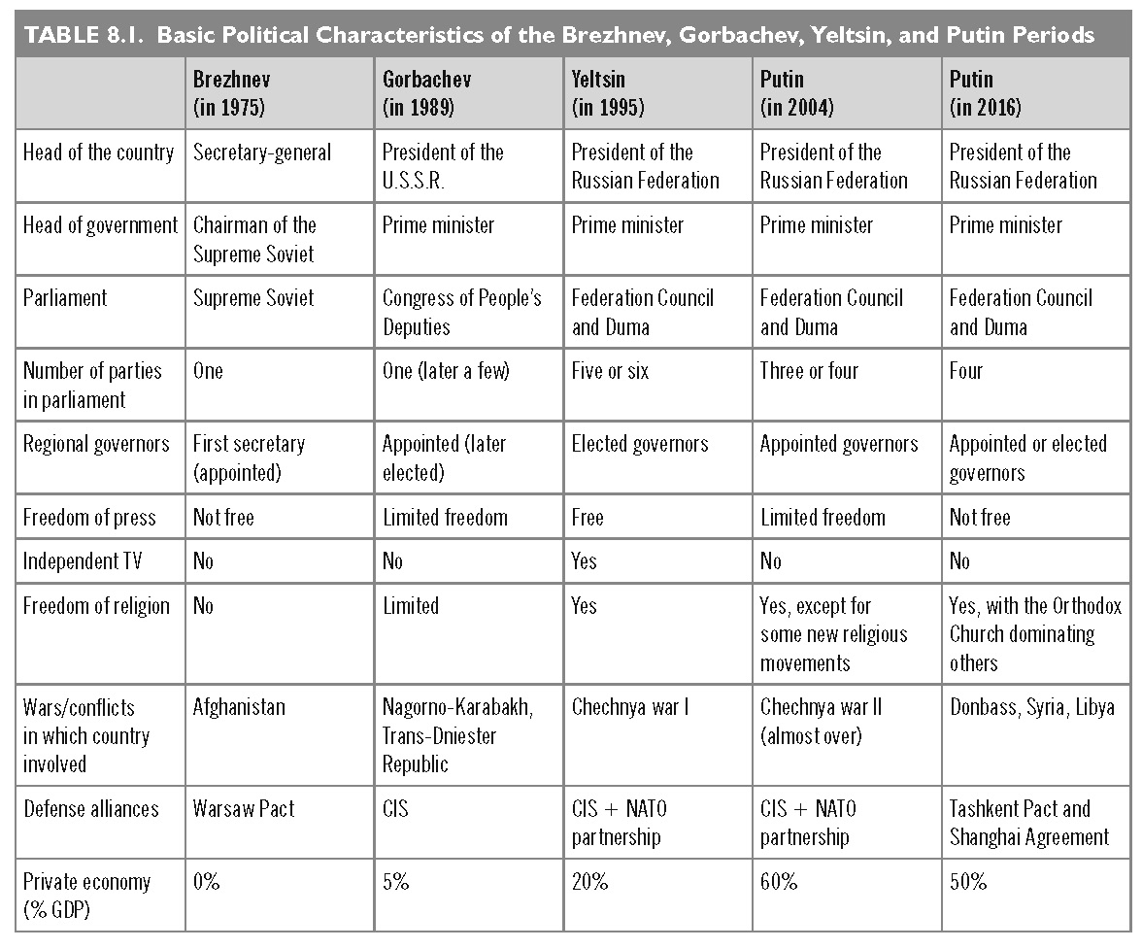
This slide is a supplement to A Geography of Russia and Its Neighbors, Second Edition by Mikhail S. Blinnikov. Copyright © 2021 The Guilford Press.

Slide 17
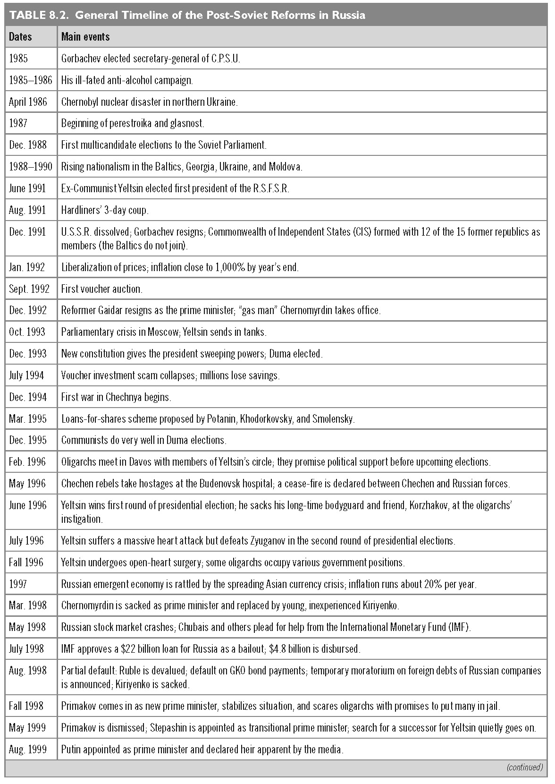
This slide is a supplement to A Geography of Russia and Its Neighbors, Second Edition by Mikhail S. Blinnikov. Copyright © 2021 The Guilford Press.

Slide 18
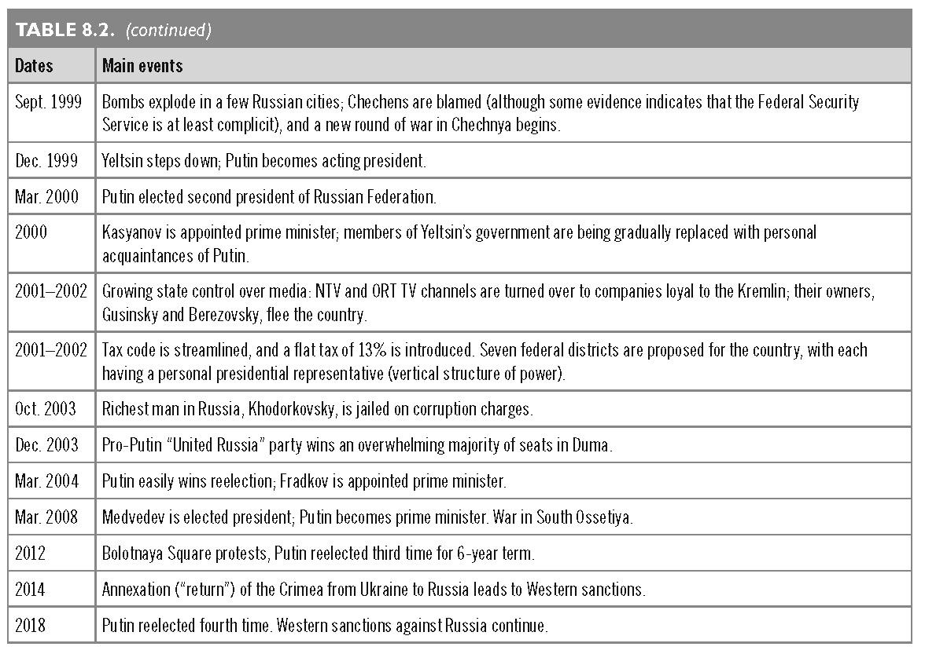
This slide is a supplement to A Geography of Russia and Its Neighbors, Second Edition by Mikhail S. Blinnikov. Copyright © 2021 The Guilford Press.

Slide 19
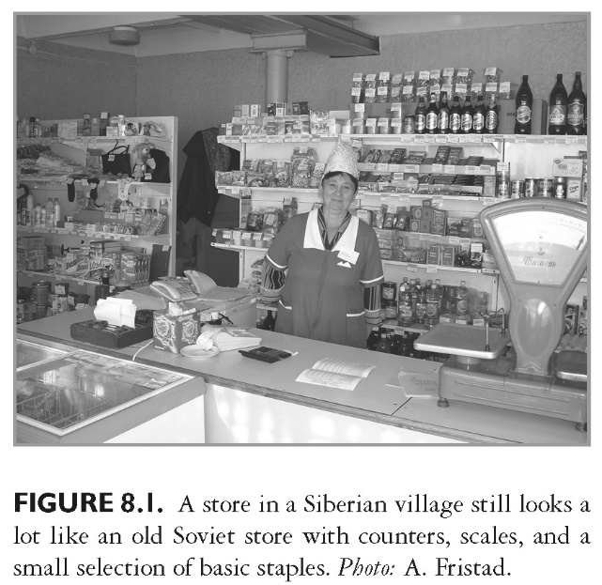
This slide is a supplement to A Geography of Russia and Its Neighbors, Second Edition by Mikhail S. Blinnikov. Copyright © 2021 The Guilford Press.

Slide 20
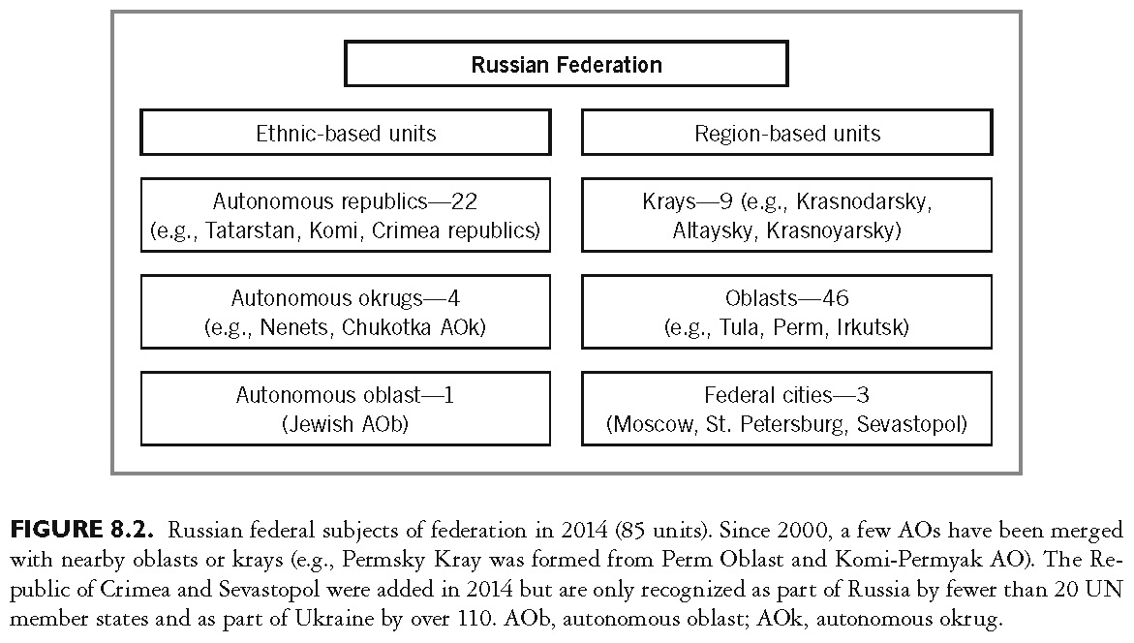
This slide is a supplement to A Geography of Russia and Its Neighbors, Second Edition by Mikhail S. Blinnikov. Copyright © 2021 The Guilford Press.

Slide 21
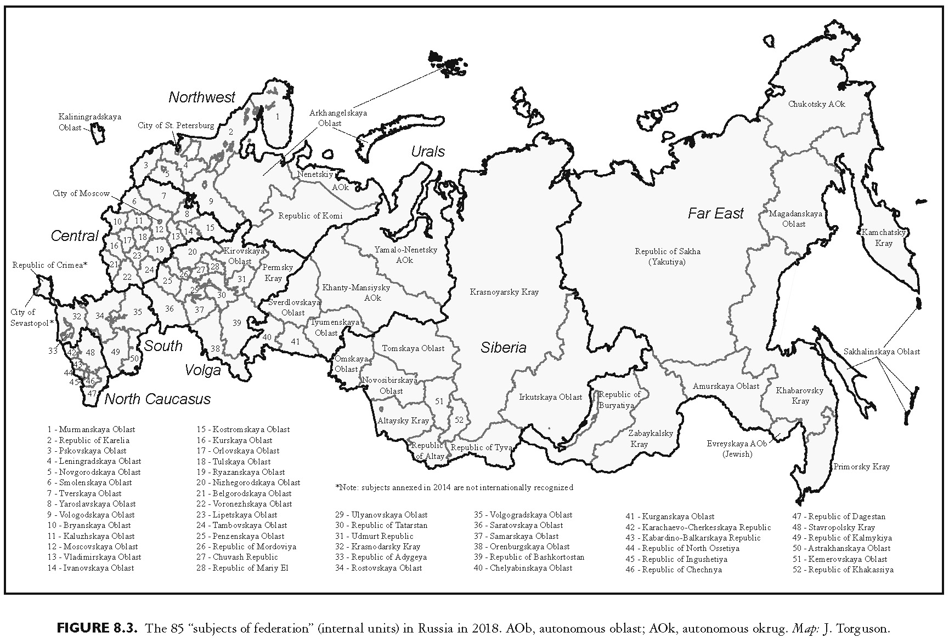
This slide is a supplement to A Geography of Russia and Its Neighbors, Second Edition by Mikhail S. Blinnikov. Copyright © 2021 The Guilford Press.

Slide 22
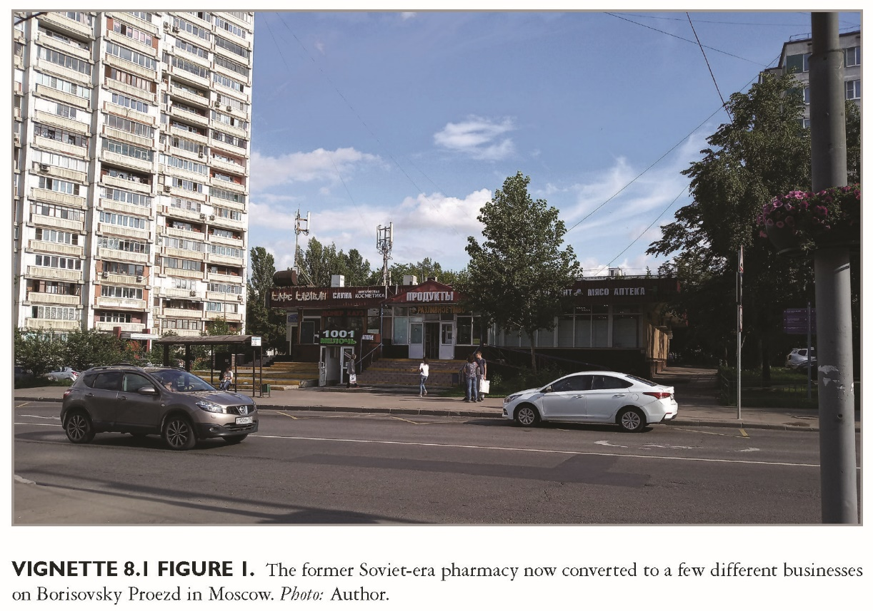
This slide is a supplement to A Geography of Russia and Its Neighbors, Second Edition by Mikhail S. Blinnikov. Copyright © 2021 The Guilford Press.

Slide 23
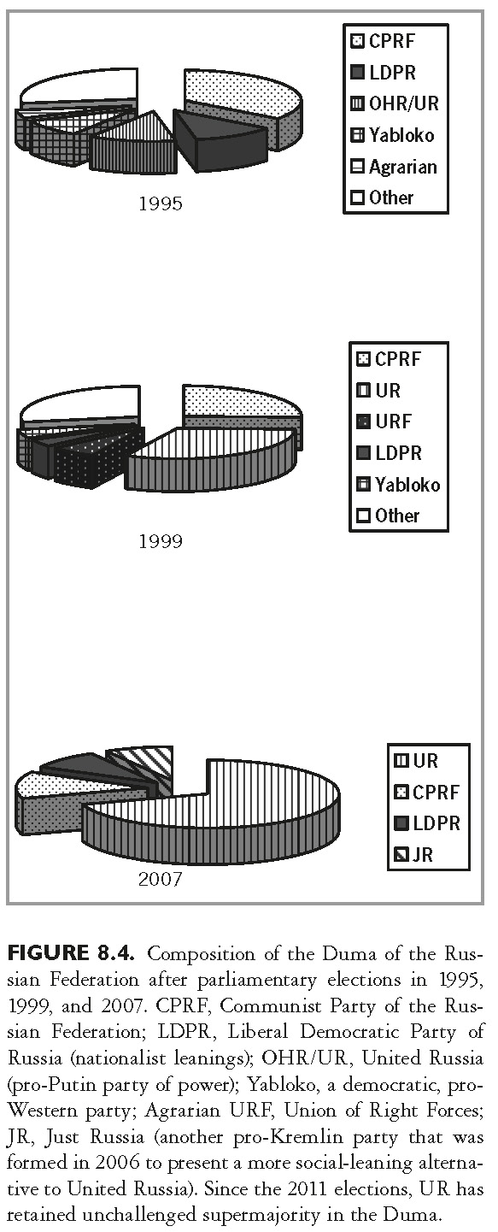
This slide is a supplement to A Geography of Russia and Its Neighbors, Second Edition by Mikhail S. Blinnikov. Copyright © 2021 The Guilford Press.

Slide 24
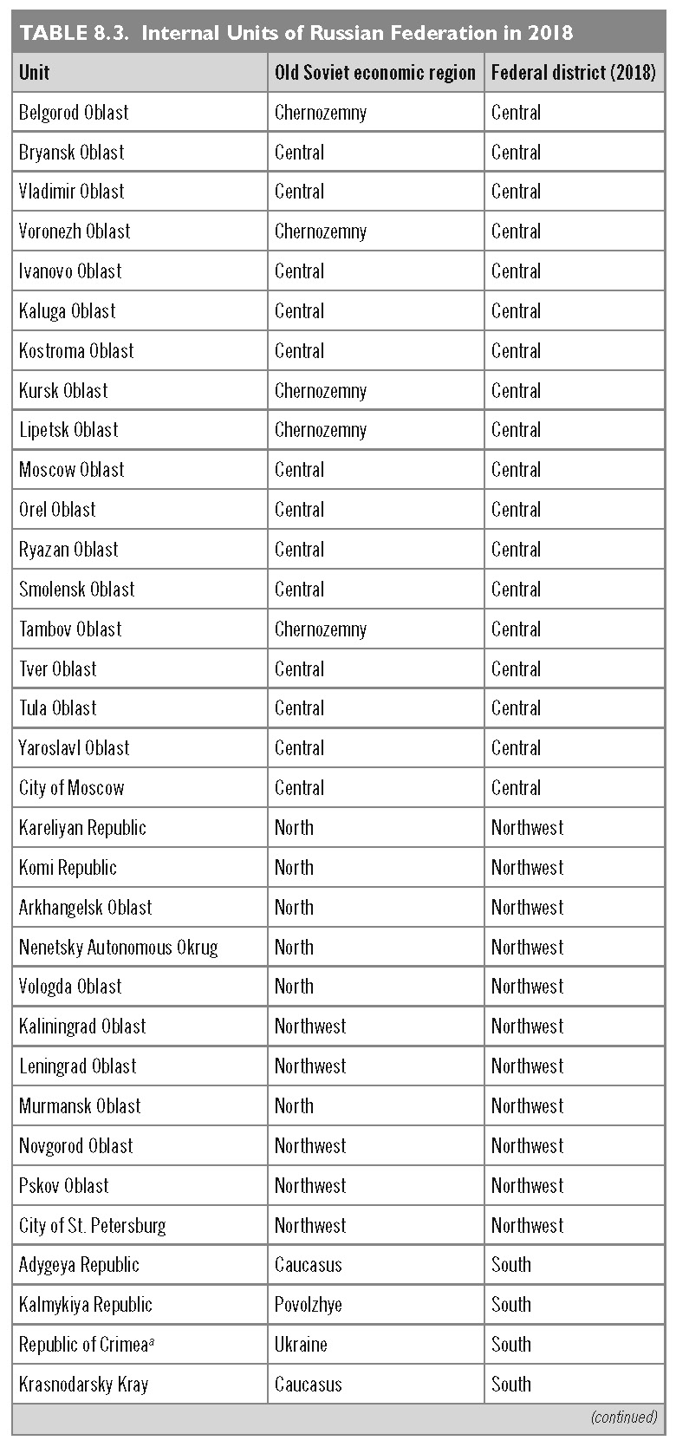
This slide is a supplement to A Geography of Russia and Its Neighbors, Second Edition by Mikhail S. Blinnikov. Copyright © 2021 The Guilford Press.

Slide 25
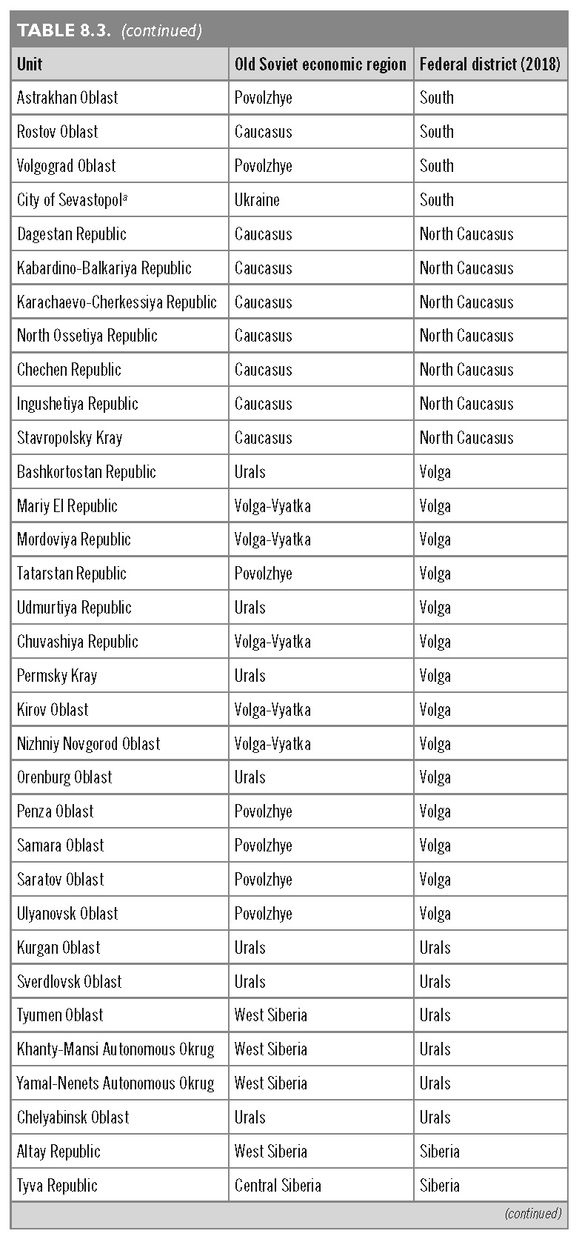
This slide is a supplement to A Geography of Russia and Its Neighbors, Second Edition by Mikhail S. Blinnikov. Copyright © 2021 The Guilford Press.

Slide 26
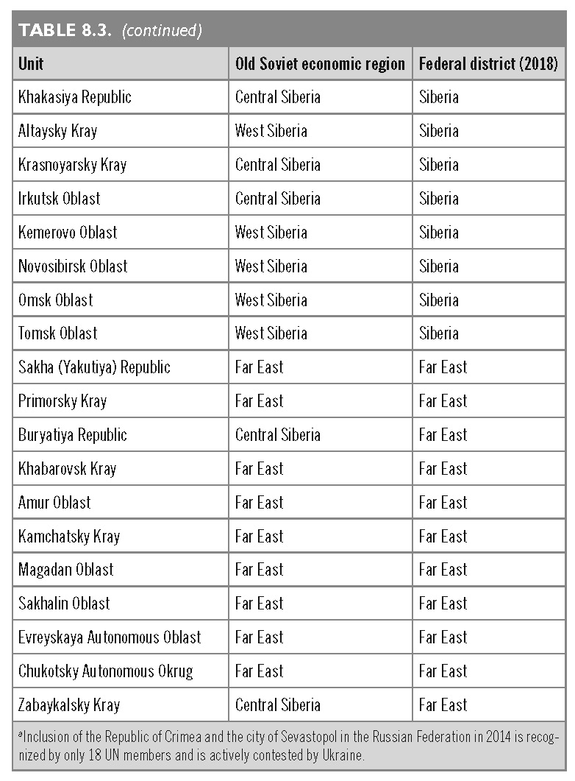
This slide is a supplement to A Geography of Russia and Its Neighbors, Second Edition by Mikhail S. Blinnikov. Copyright © 2021 The Guilford Press.

